Slide 1
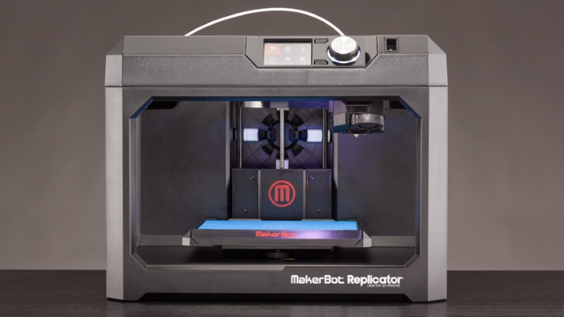
3D Scanning and Object Capture
By: Casey Feinstein and Hadley Saba

Slide 2
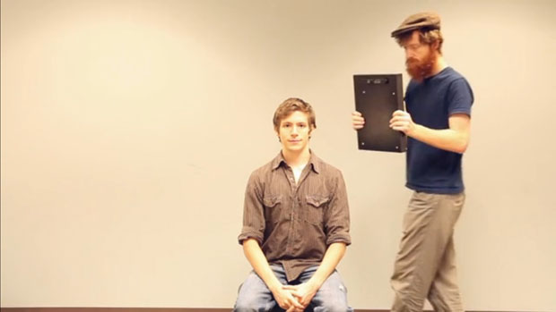
Introduction
For our final STEM project, we decided to take a three dimensional approach. The name of our topic was “3D object capture”. In this PowerPoint, you will learn what 3D Object Capture is (including the past, present and future of it), how we decided to use it, and whether we were successful or not.

Slide 3
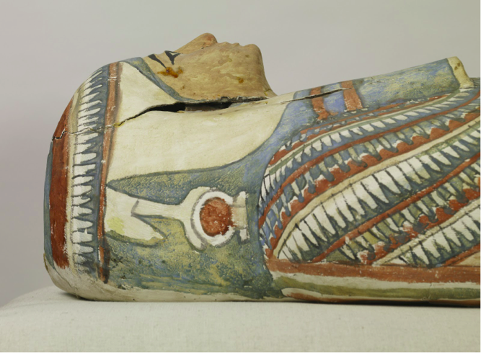
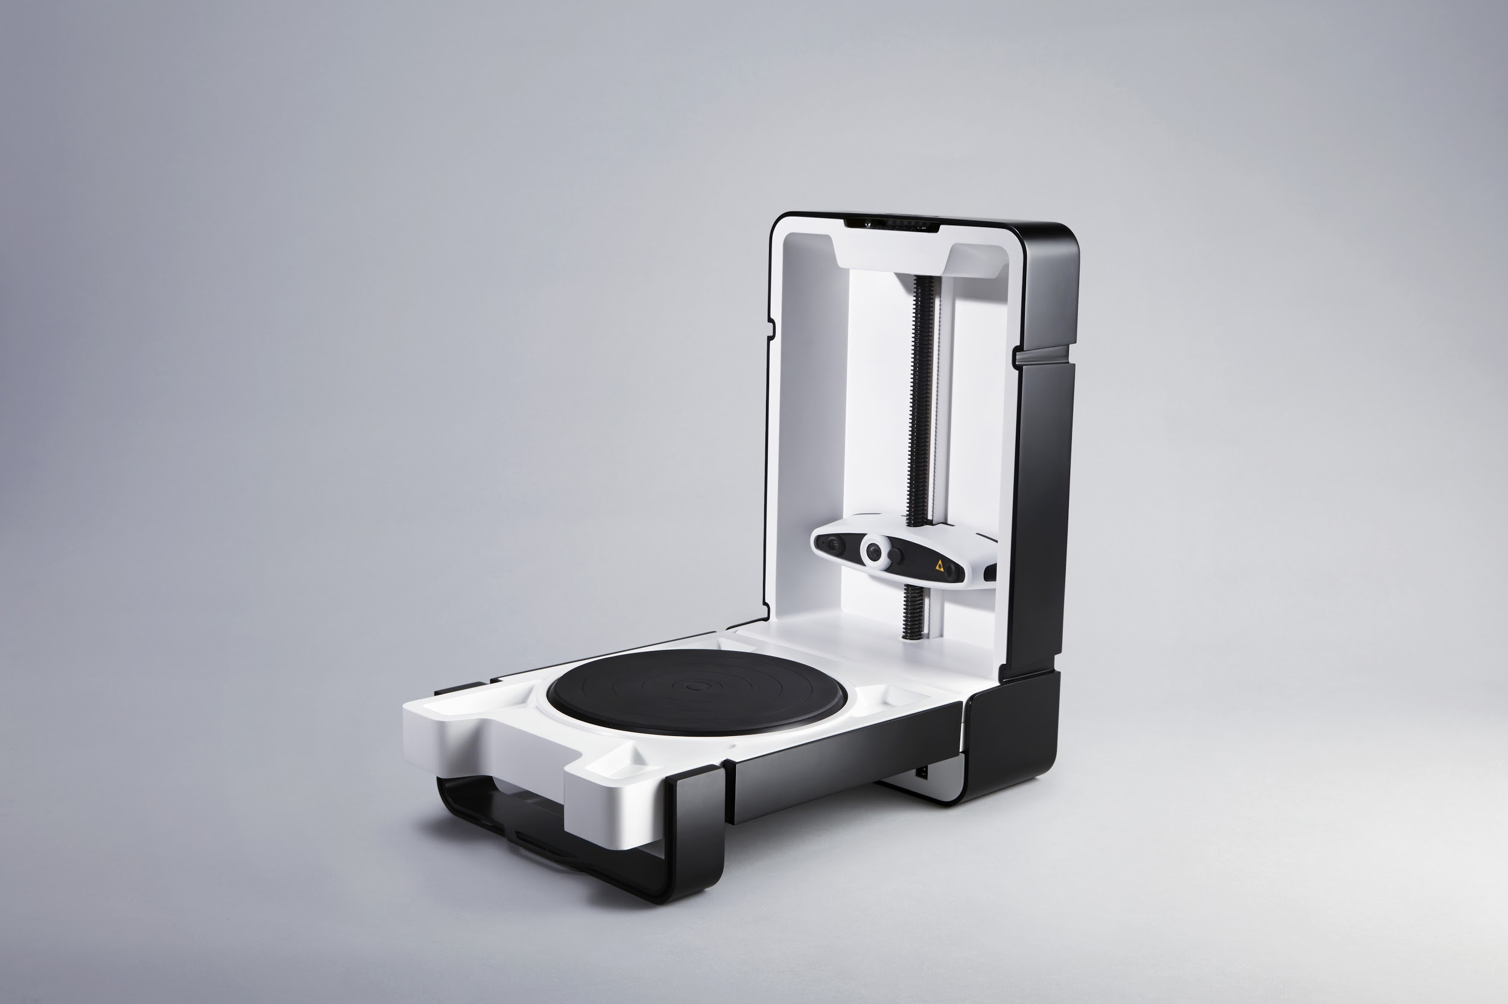
Background: It goes wayyy back…
Ancient Egyptians made 3D plaster-casted replicas of mummy heads. It required materials such as linen and plaster, which were rare and hard to obtain back then → very time consuming
The earliest digital 3D scanners appeared in the 1980s. These scanners used contact probes ---> also very time consuming and expensive
Storage space increased as time went on → faster and better ways to 3D scan
Present: Now scanners are more easily accessible, cheaper, and more user friendly than ever before.

Slide 4
What was our objective for our proposal?
Our objective was to digitize a complex 3D object and print a model of it using the 3D printers in our school.
The objects in the running for digitization were Hadley’s head, a globe and a hand… Hadley’s head won.

Slide 5
Program Apps/Tutorial
We attempted to use a program called “123D Catch” which was an app suggested by an RPCS student who tried this project approach in the past, but the company recently disabled the download of it. Since we were unable to use this app, we did some more research and found another 3D object capture app…
The program we used to capture our 3D object was called “TRNIO”, which is an app you can download on your mobile device to “Model your world in true 3D”.
Tutorial Link: https://vimeo.com/137196289

Slide 6
Complications
After taking multiple pictures of our subject, one preview showed a face but with a massive gap in the back of the head. Another didn’t have as much of a gap in the back of the head, but the face showed a deformed, split image.
When proceeding to try to publish these previews, they did not publish until a couple of days later when we no longer had access to the 3D printer (over the long weekend).
Once it finally published, there was no option to export the file into our MakerBot program, therefore disabling us from being able to print.
Even though there were many complications, we still managed to capture a 3D object - Hadley’s head!!!

Slide 7
Complications (continued)
Lighting:
As seen in the tutorial, the lighting must be even for the capture to work. In many of our trials, the lighting was not even, thus forcing the captures to turn out abnormally.
Hair:
As also seen in the tutorial, it was recommended to not have plain, monocolored objects be captured. We believe this is why the back of Hadley’s head did not quite make the cut into the capture.
Movement:
In some of our trials that we decided to go outside for lighting purposes, it was rather windy, causing there to be movement in our shots, making our captures even more abnormal.

Slide 8
(Semi) Finished Products
Disclaimer: The following images you are about to see may appear rather weird. We promise this is not what Hadley actually looks like…
http://trn.io/8/8S3an4zv5q/
http://trn.io/y/ydPtOLRI1R/

Slide 9
The Future of TRNIO and 3D Capture
In a recent blog post made by TRNIO, the company addresses the “back of the head problem”:
“You might have noticed that scanning people's faces from ear to ear leaves out the back of the their heads. Because of this, we are currently developing our technology to allow our users to get full 360-degree hi-res captures of people's heads. Click on the model below to see an example of an amazing face-scan.”
With growing technology, and the relatively short time period in which 3D scanning has been around, we can predict that the future will hold many 3D capture and scanning innovations.
Scientists at Carnegie Mellon University hope in the near future to “[realistically capture] real world objects that can be manipulated in real-time”.

Slide 10
Sketchfab
Through a program called Sketchfab, which is linked to TRNIO, we uploaded our scan.
Through this program, we were able to edit the model, but we were not able to export the scan into Makerbot, which was our ultimate goal.
There were no settings to save the file - only view it and edit it.
https://sketchfab.com/models/a69b4295d12b4529b6cbe8368dca317a

Slide 11
Conclusion
Although we were ultimately unsuccessful, we now know what we would do differently in the future:
Choose a different 3D capture app that is able to connect with MakerBot and that doesn’t have unresolved program issues.
Allot more time for the captures to download and publish
This was a great experience for the both of us, and we hoped you enjoyed learning about it as well!

Slide 12
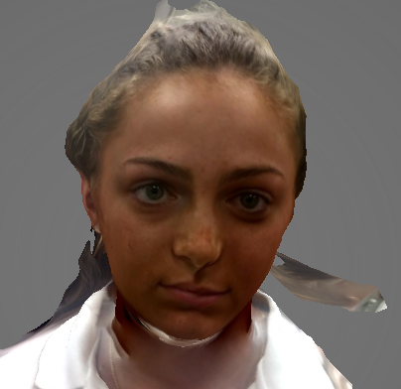
Thank you for your attention.

Slide 13
Bibliography
http://www.trnio.com/
https://matterandform.net/blog/a-brief-history-of-3d-scanning
https://sketchfab.com
https://3dprintingindustry.com/news/the-future-of-3d-scanning-the-latest-research-from-carnegie-mellon-university-50506/
http://www.dayzeesdiversion.com/3d-printer-solutions-and-more-information/
https://petapixel.com/2013/02/04/lynx-a-the-worlds-first-point-and-shoot-3d-camera/

